Slide 1

Organizational Behavior
(MGT-502)
Lecture-27

Slide 2
Summary of
Lecture-26

Slide 3
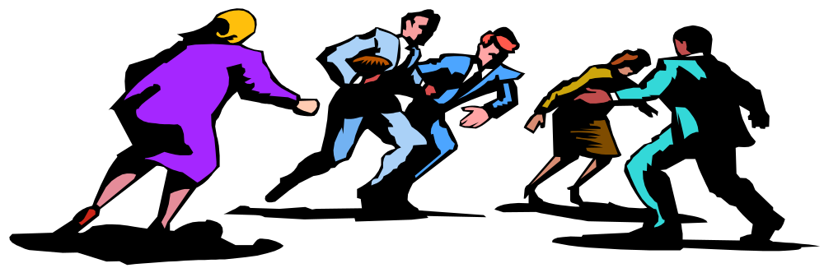
Definition - Conflict
"a process which begins when one party perceives that the other is frustrated, or is about to frustrate, some concern of his (or her).

Slide 4
Definition of Conflict
Perceived by the parties
Parties are in opposition to one another
At least one party is blocking the goal attainment of the other party
Goals can be tangible or psychological
  Money
  Task Achievement
  Happiness

Slide 5

Types of Conflict
Task conflict
Conflict over content and goals of the work
Relationship conflict
Conflict based on interpersonal relationships
Process conflict
Conflict over how work gets done

Slide 6
Levels and Types of Conflict
Level of conflict
Type of conflict
Organization
Within and between organizations
Group
Within and between groups
Individual
Within and between individuals

Slide 7
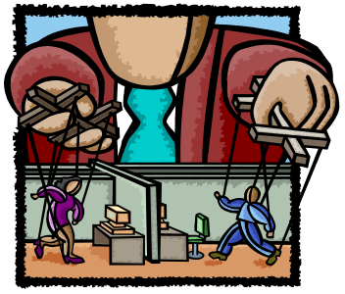
Sources of conflict
Organizational hierarchy
Competition for scarce resources
Self-image & stereotypical views of others
Differing goals & objectives
Failures & resultant blame fixing
Poor coordination of activities

Slide 8
Is Conflict Bad?
Traditional View
Human Relations
Interactionist

Slide 9
Today’s Topics

Slide 10

Conflict Management
Conflict at Work

Slide 11
Conflict Management Styles
Avoiding - deliberate decision to take no action on a conflict or to stay out of a conflict
Accommodating - concern that the other party’s goals be met but relatively unconcerned with getting own way
Competing - satisfying own interests; willing to do so at other party’s expense
Notes:
21

Slide 12
Conflict Management Styles
Compromising - each party gives up something to reach a solution
Collaborating - arriving at a solution agreeable to all through open & thorough discussion
Notes:
21

Slide 13
Five Conflict Management Styles
Competing
Collaborating
Assertive
Compromising
Assertiveness
Unassertive
Avoiding
Accommodating
Uncooperative
Cooperative
Cooperativeness

Slide 14
Avoidance Is Appropriate When...
You have no chance of satisfying your concerns
let people cool down

Slide 15
Accommodation Is Appropriate When ...
You realize you are wrong
Issue is much more important to other party
To build up credit for later negotiations
To preserve harmony

Slide 16
Competition Is Appropriate When...
No long term relationship
To protect yourself against untrustworthy parties
Unpopular courses of action need implementation
Issues are vital to your welfare

Slide 17
Collaboration Is Appropriate When ...
Both parties’ concerns are too important to be compromised
To gain commitment
Time is not an issue

Slide 18
Compromising Is Appropriate When ...
Goals are less important to you than collaboration
Mutually exclusive goals
To achieve temporary settlements
Under intense time pressure

Slide 19
Negotiation Skills

Slide 20
What is negotiation?
Negotiation.
  The process of making joint decisions when the parties involved have different preferences.

Slide 21
Negotiation
Negotiation - a joint process of finding a mutually acceptable solution to a complex conflict
Useful under these conditions
  Two or more parties
  Conflict of interest between the parties
  Parties are willing to negotiate
  Parties prefer to work together rather than to fight openly, give in, break off contact, or take the dispute to a higher authority
Notes:
23

Slide 22

Approaches to Negotiation
Distributive Bargaining –
the goals of the parties are in conflict, and each party seeks to maximize its resources

Slide 23
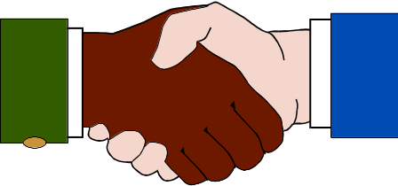
Approaches to Negotiation
Integrative Negotiation –
focuses on the merits of the issues and seeks a win-win solution

Slide 24
Steps in a Negotiation
Identify the problem
Define the goal
Record the facts
Anticipate outcomes
Notes:
5

Slide 25
The Process of Negotiation
Preparation
and Planning
Clarification and
Justification
Closure and
Implementation
Definition of
Ground Rules
Bargaining and
Problem
Solving

Slide 26
Bargaining Zone Model
Your Positions
Initial
Target
Resistance
Area of
Potential
Agreement
Resistance
Target
Initial
Opponent’s Positions

Slide 27
Essential skills are
Planning and preparing thoroughly before a negotiation
Using appropriate techniques during the negotiation
Following up effectively
Evaluating the effectiveness of a negotiation
Notes:
3

Slide 28
Mapping the Negotiation
Describe the problem of the negotiation
Identify the people involved
Use empathy to analyze the situation
Record participants’ needs and fears about the problem
Notes:
7

Slide 29
Anticipate possible outcomes
Consider and evaluate a wide range of likely outcomes before the negotiation starts
Notes:
9

Slide 30
Determine the Negotiation Outcome
Win/lose
Lose/lose
Win/win
Notes:
11

Slide 31
Principled Negotiation
Separate the people from the problem
Focus on interests not positions
Generate a variety of possibilities before deciding what to do
Insist that the result be based on some objective standard
Notes:
16

Slide 32
Planning checklist
Has the problem been identified?
Is the goal of the negotiation clear?
What do you want to keep?
What are you prepared to give up?
Have all relevant facts been recorded?
What are the possible outcomes of the negotiation?
Is there a contingency plan in place?
Notes:
17

Slide 33
Conducting the Negotiation
Use an appropriate negotiation style
Use suitable language
Use effective responding and listening techniques
Identify needs and wants
Notes:
18

Slide 34
Conducting the Negotiation
Set up the negotiation
Create the non-verbal environment
Start the negotiation
Deal with conflict during the negotiation
Achieve a negotiated outcome
Notes:
19

Slide 35
Setting up the Negotiation
Time
Location
Furniture and seating
Team members
Notes:
24

Slide 36
Evaluate the Negotiation
Identify action to be taken
Write down each step
Record decisions for future reference
Identify who is responsible for each step of the implementation process
Notes:
29

Slide 37

Third-Party Negotiations

Slide 38
Third-Party Objectives
Procedural
Fairness
Efficiency
Third-Party
Conflict Resolution
Objectives
Outcome
Fairness
Effectiveness

Slide 39
Negotiation Issues
Gender
Differences
Personality
Traits
Cultural
Differences

Slide 40
Issues in Negotiation
The Role of Personality Traits in Negotiation
  Traits do not appear to have a significantly direct effect on the outcomes of either bargaining or negotiating processes.
Gender Differences in Negotiations
  Women negotiate no differently from men, although men apparently negotiate slightly better outcomes.
  Men and women with similar power bases use the same negotiating styles.
  Women’s attitudes toward negotiation and their success as negotiators are less favorable than men’s.

Slide 41
Culture and negotiation.
  Differences in negotiation approaches and practices are influenced by cultural differences in:
    Time orientation.
    Individualism-collectivism.
    Power distance.

Slide 42
Effective Negotiator Behaviours
Plan and Set Goals
Gather Information
Communicate Effectively
Make Appropriate Concessions

Slide 43
Ethical aspects of negotiation.
To maintain good working relationships, negotiating parties should strive for high ethical standards.
The negotiating parties should avoid being side tracked by self-interests, thereby being tempted to pursue unethical actions.

Slide 44
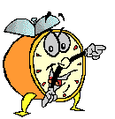
Let’s stop it here

Slide 45
Summary

Slide 46
Conflict Management
Conflict at Work

Slide 47
Five Conflict Management Styles
Competing
Collaborating
Assertive
Compromising
Assertiveness
Unassertive
Avoiding
Accommodating
Uncooperative
Cooperative
Cooperativeness

Slide 48
Negotiation Skills

Slide 49
Steps in a Negotiation
Identify the problem
Define the goal
Record the facts
Anticipate outcomes
Notes:
5

Slide 50
Third-Party Negotiations

Slide 51
Ethical aspects of negotiation.
To maintain good working relationships, negotiating parties should strive for high ethical standards.
The negotiating parties should avoid being side tracked by self-interests, thereby being tempted to pursue unethical actions.

Slide 52
Next….

Slide 53
Organizational Behavior
(MGT-502)
Lecture-27

